Slide 1
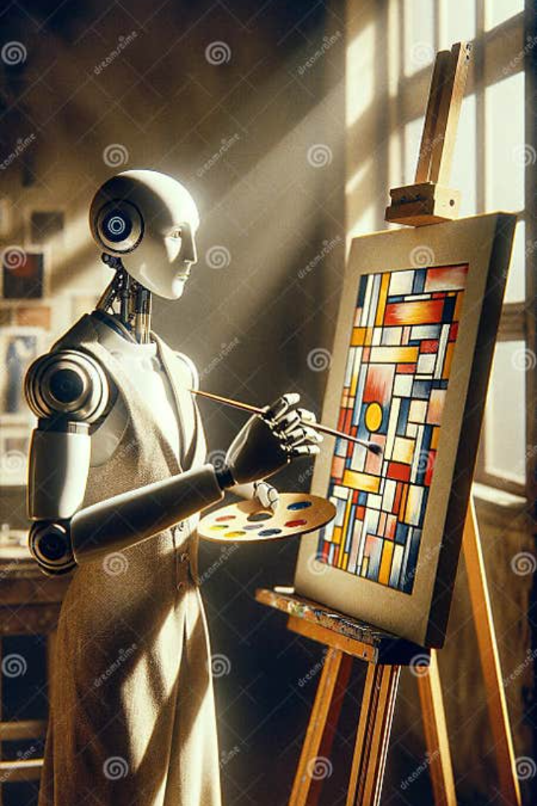
AI VIRTUAL PAINTER: Revolutionizing Digital Art Creation
Welcome to the world of AI Virtual Painter, a groundbreaking technology that combines Convolutional Neural Network (CNN) model and OpenCV to transform digital art creation.
Team Members: Sairin Ray Choudhury - 00865659
Venugopal Sukka - 00877615
VS

Slide 2
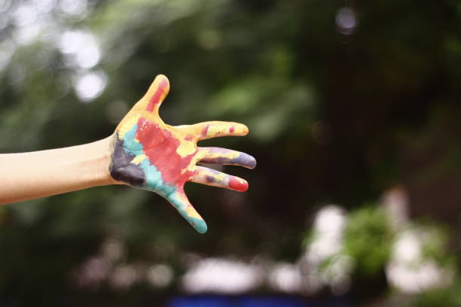
Objective
The primary objective of our project is to craft a unified means of communication that can proficiently express our ideas.
This painting software is developed using the Python programming language in conjunction with the CNN (Convolutional Neural Network) and OpenCV module, a powerful machine learning tool.
It leverages real-time webcam data to enable users to draw with the aid of an object-of-interest that is tracked using the OpenCV library.
This unique approach adds a challenging and awe-inspiring dimension to creating simple drawings.

Slide 3
Approach
Read Frames and convert to HSV color space
Prepare Canvas frame and put ink buttons on it
Adjust taskbar to find mask of colored marker
Pre-process mask with morphological operations
Erosion and Dilation
Draw the ports stored in array on frame and canvas
Keep storing in arrays for next frames
Find center coordinates of largest contour
Detect the Contours
Tools and Techniques used are: CNN, Python, Feature libraries- OpenCV, NumPy and Framework - MediaPipe

Slide 4
Dive deep into the architecture and functionality of the Convolutional Neural Network (CNN) model, which serves as the backbone of the AI Virtual Painter. A convolutional neural network (CNN or ConvNet) is a network architecture for deep learning that learns directly from data.
CNNs are particularly useful for finding patterns in images to recognize objects, classes and categories. They can also be quite effective for classifying audio, time-series, and signal data.
The Convolutional layer applies filters to the input image to extract features, the Pooling layer down samples the image to reduce computation, and the fully connected layer makes the final prediction. The network learns the optimal filters through backpropagation and gradient descent.
Overview of Convolutional Neural Network Model

Slide 5
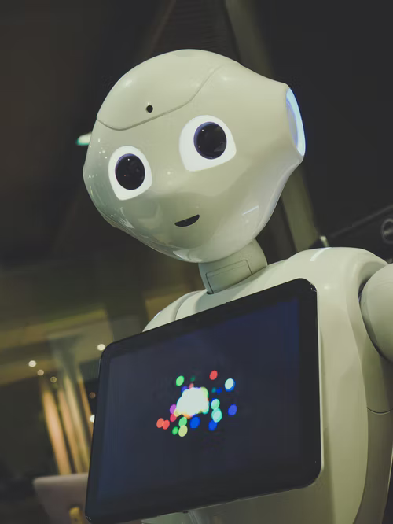
Working
Virtual AI painter using CNN and Python is an application designed for object tracking.
The application allows the user to draw on the screen in real-time.
Object tracking is based on the movement of an object, such as the human hand, in front of a webcam.
The tracking of the object in real-time using webcam data enables the user to create drawings.
Drawing with this application is an interesting and challenging experience.
Human gestures are recognized by vision, and computer vision is used to examine various gestures. The system will use computer vision to trace the finger's path, and in that way. It is an effective communication method that reduces the need to write. Web camera is used to extract the gestures of the hand in order to achieve fast and stable gesture recognition in real time.

Slide 6
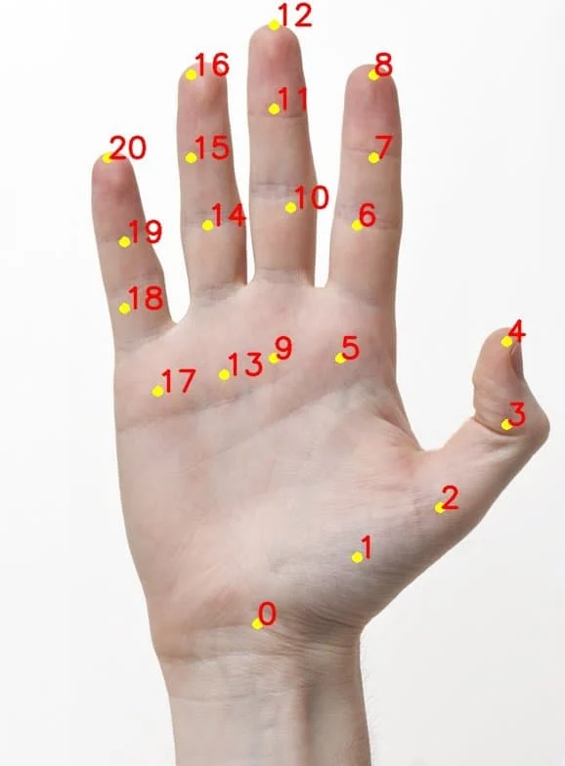
Evaluation Methodology
Draw by holding your index finger up.
Erase by holding both index and middle finger up.
Change colors by selecting the desired color using selection mode

Slide 7
Features and Functionality of the AI Virtual Painter
Real-time Art Generation
Intelligent Color Suggestions
Witness the AI Virtual Painter's ability to transform your ideas into stunning artworks instantly. Experience the thrill of seeing your imagination come to life with a few simple strokes.
Discover how the AI Virtual Painter analyzes your artwork and provides intelligent color suggestions, taking your creativity to new heights. Say goodbye to guesswork and let AI guide your artistic choices.
Adaptive Style Transfer
Multi-platform Compatibility
Explore the AI Virtual Painter's adaptive style transfer capabilities, which allow you to seamlessly merge various art styles into your creation. Experience the fusion of artistic expressions like never before.
Experience the convenience of the AI Virtual Painter across multiple platforms. Whether you're using a desktop, tablet, or smartphone, unleash your creativity anytime, anywhere.

Slide 8

How to Use the AI Virtual Painter for Digital Painting
1
Step 1: Choose Your Canvas
Select the canvas size and format that suits your artistic vision. The AI Virtual Painter provides a range of options to bring your ideas to life.
Step 2: Sketch Your Vision
2
Sketch your artistic concept using the AI Virtual Painter's intuitive drawing interface. Let your creativity flow as you outline the foundation of your masterpiece.
3
Step 3: Enhance and Refine
Utilize the AI Virtual Painter's suite of tools to enhance and refine your artwork. Experiment with colors, textures, and styles to unlock new dimensions of creativity.

Slide 9
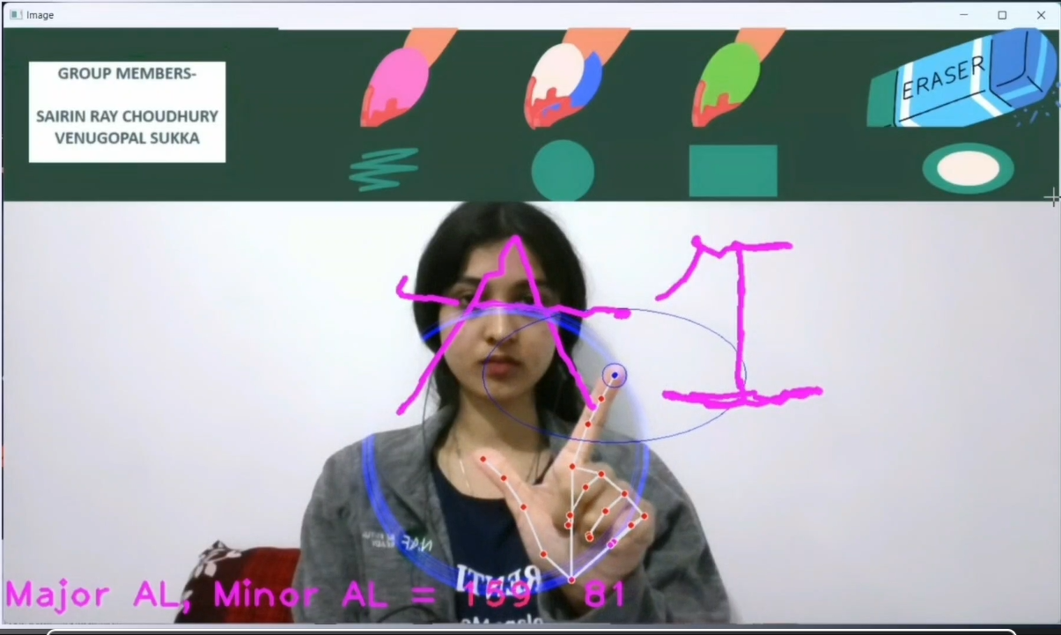
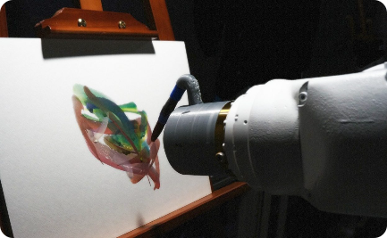
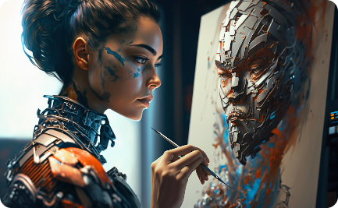
Demonstration of the AI Virtual Painter
Live Art Showcase
Masterpieces Created by AI
User Experience and Testimonials
Experience the mesmerizing process of the AI Virtual Painter in action. Witness the magic unfold as AI transforms the digital canvas into awe-inspiring artworks.
Marvel at a collection of extraordinary artworks created by the AI Virtual Painter. Explore the intersection of human creativity and artificial intelligence.

Slide 10
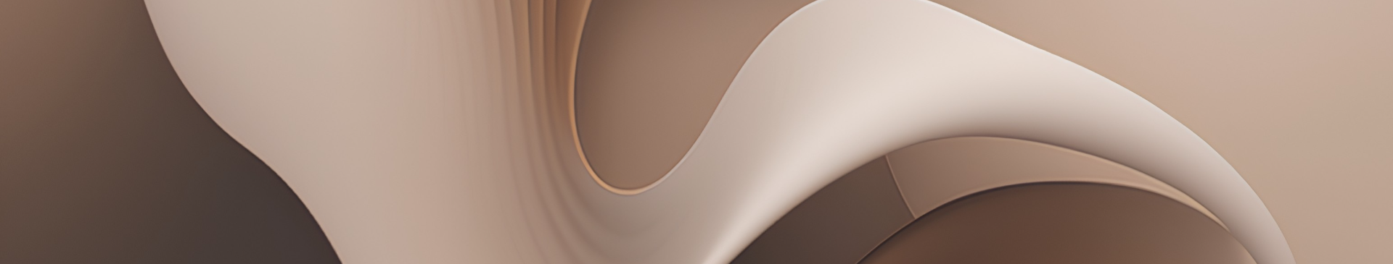
Conclusion and Future Scope of AI Painting Technology
As we conclude this journey through the realm of AI Virtual Painter, reflect on the impact it has made on the art world. Exploring the future possibilities and prospects of AI painting is to ensure that, the interface is very simple and easily understandable by the user.
The user should be able to draw what he/she wishes to draw without any interruptions. In future, this is useful for making kids to learn drawing in schools in an interactive way.

